Slide 3
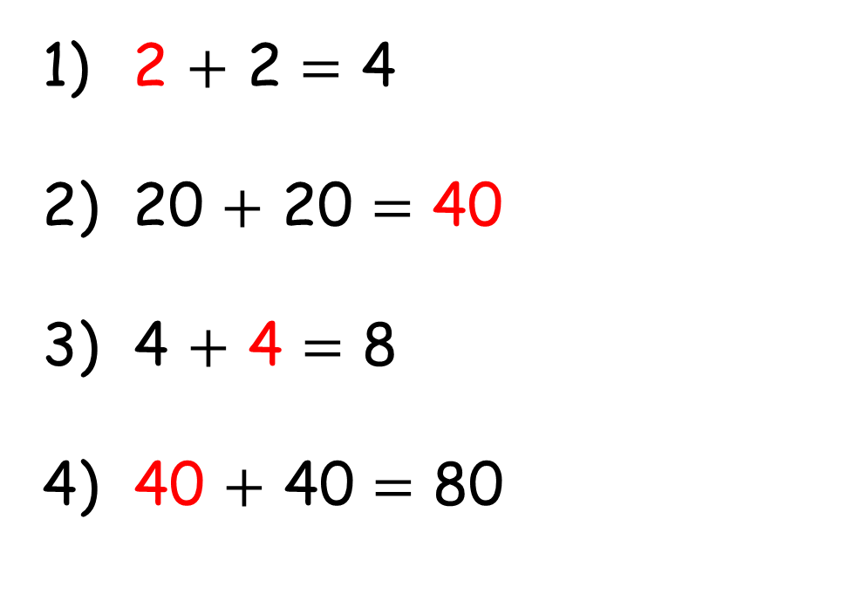
2 $+$ 2 $=$ 4
20 $+$ 20 $=$ 40
3) 4 $+$ 4 $=$ 8
4) 40 $+$ 40 $=$ 80

Slide 4
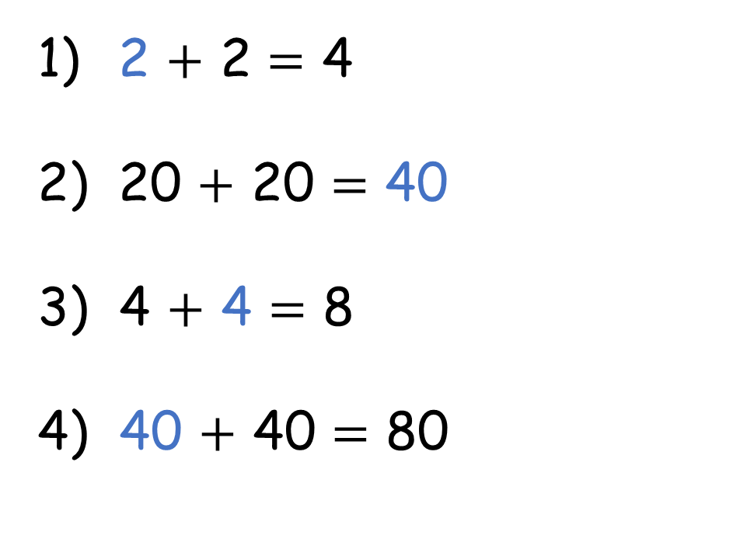
2 $+$ 2 $=$ 4
20 $+$ 20 $=$ 40
3) 4 $+$ 4 $=$ 8
4) 40 $+$ 40 $=$ 80

Slide 6
2
$+$ 8 $=$
$=$ 10

Slide 7
2
$+$ 8 $=$
10
20
$+$ 80 $=$
100

Slide 8
3 tens $+$ 7 tens $=$ 10 tens
30 $+$ 70 $=$ 100

Slide 9
3 tens $+$ 7 tens $=$ 10 tens
4 tens $+$ 6 tens $=$ 10 tens
4 tens $+$ 7 tens $=$ 10 tens
4 $+$ 7 $=$ 11

Slide 10
Have a go at questions 1 and 2 on the worksheet

Slide 11
3
$$+$$
4
$$=$$
7
3
0
$$+$$
4
0
$$=$$
7
0

Slide 12
Have a go at question 3 on the worksheet

Slide 13
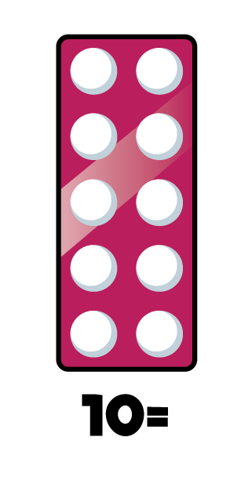
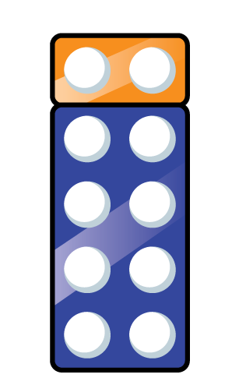
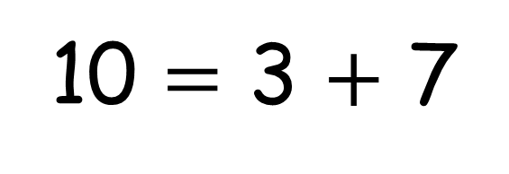
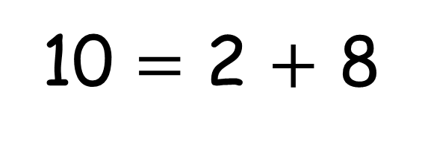
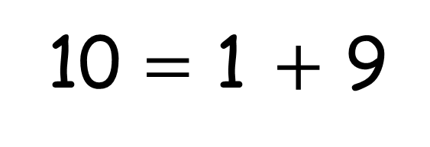
10 $=$ 1 $+$ 9
10 $=$ 2 $+$ 8
10 $=$ 3 $+$ 7

Slide 14
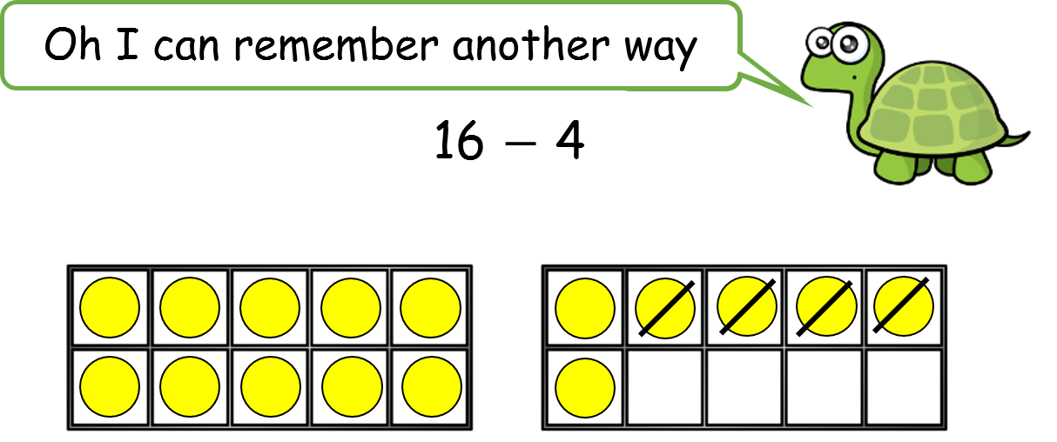
10 $=$ 1 $+$ 9
10 $=$ 2 $+$ 8
10 $=$ 3 $+$ 7

Slide 15
Have a go at question 4 on the worksheet

