Slide 3
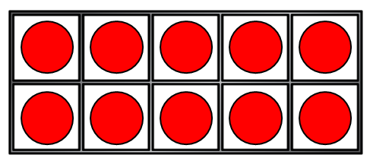
1) How many counters?
2) What number is missing? 8, 7, 6, __ , 4
3) How many pencils?
4) How do you spell 1?

Slide 4
10
1) How many counters?
2) What number is missing? 8, 7, 6, __ , 4
3) How many pencils?
4) How do you spell 1?
5
3
o-n-e

Slide 6
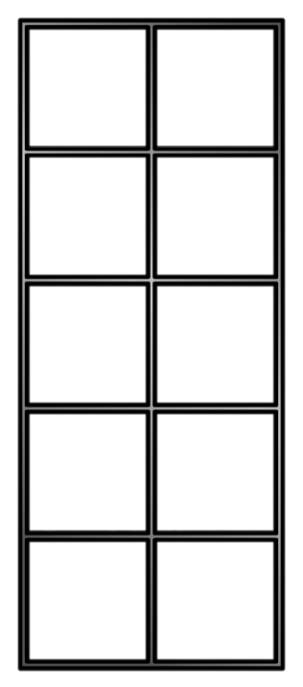
Count one less with ten frames
How many counters?
Count one less
One less than 6 is
5
One less than 8 is
7
One less than 4 is
3
One less than 10 is
9

Slide 7
Have a go at question 1 on the worksheet

Slide 8
Count one less with number tracks
1 | 2 | 3 | 4 | 5 | 6 | 7 | 8 | 9 | 10
8
One less than 9 is
One less than 2 is
1
4
One less than ___ is 3

Slide 9
Have a think
one | two | three | four | five | six | seven | eight | nine | ten
One less than 6 is .
five
One less than 3 is .
two
10
One less than ___ is nine.

Slide 10
Have a go at question 2 on the worksheet

Slide 11
I am going to take a banana and an apple to school.
There are 4 bananas.
One less than 4 is
3
There are 8 apples.
One less than 8 is
7

Slide 12
Have a go at the rest of the questions on the worksheet

