Slide 1
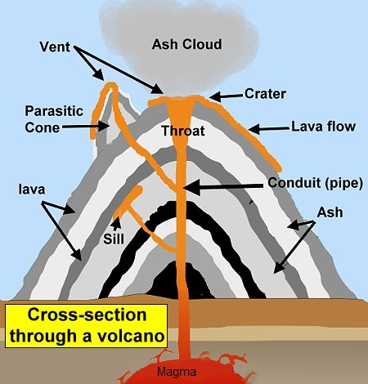
Ash cloud
Ash,steam and gas is pushed out of the top of the volcano.
This Photo by Unknown author is licensed under CC BY-SA-NC.

Slide 2
Crater
These are circular depressions at the top of the volcano.

Slide 3
Main vent
This is the main vent that connets the magma chamber to the surface.

Slide 4
LAVA
This is the molten rock after it reaches the surface.

Slide 5
Secondaey cone
This is a cone that builds up around secondary vents.

Slide 6
Secondary Vent
The magma reaches the surface with out using the main vent.

Slide 7
Magma
This is molten rock under the ground.

Slide 8
Magma Chamber
This is where the magma is stored under ground.

Slide 9
All About Volcanos
Most volcanos can be found in countries that have coastlines on the Pacific Ocean.This is called the Ring of Fire.
Tambora in Indonesia killed 1815 people.
This is the biggest eruption known to us .
The 3 types of volcanos are called active,dormant and extinct.
These are all volcanos that havent yet erupted or are now extinct.

