Slide 1
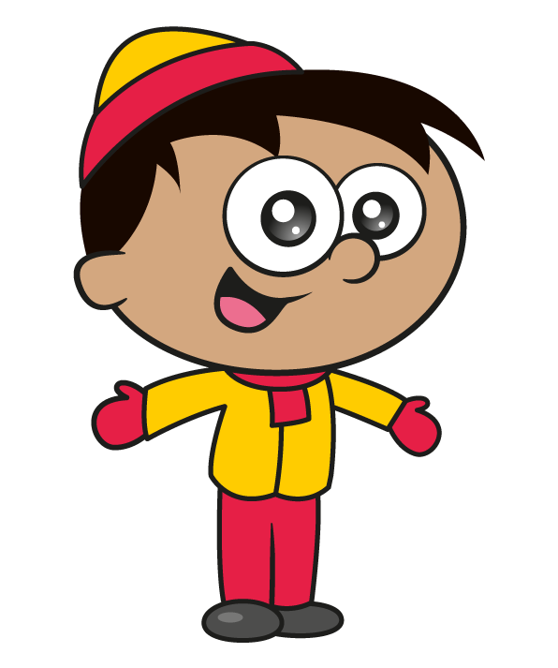
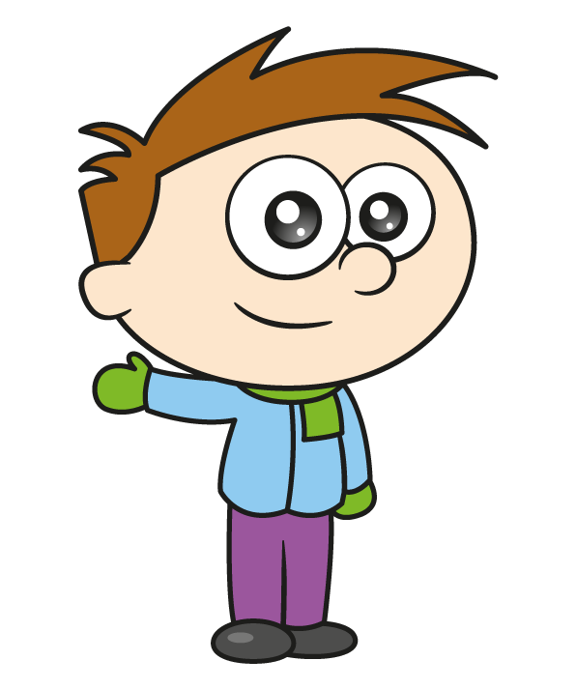
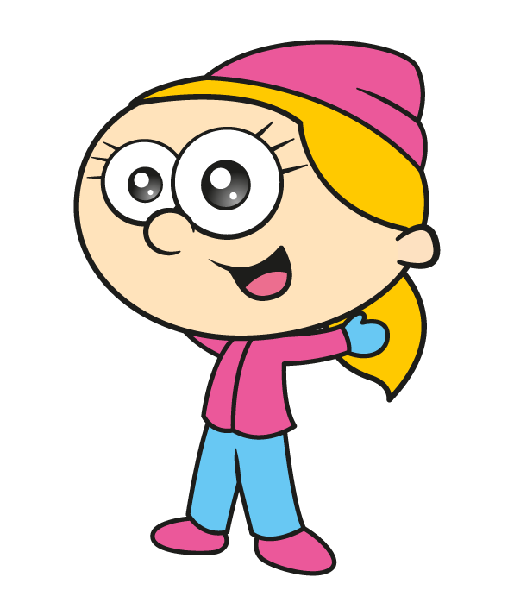
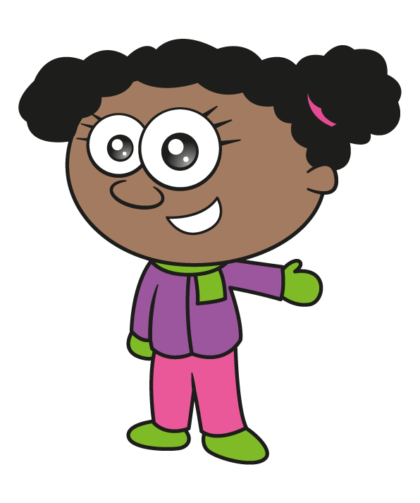

Slide 2
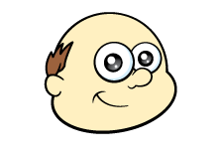
Mr Rose is knitting scarves.
He makes sections of different colours.
Each section is 8 cm long.
8 cm
How long is a scarf with 6 panels?
A second scarf is 96 cm long.
How many 8 cm panels does it have?
Have a think

Slide 3
Mr Rose is knitting scarves.
He makes sections of different colours.
Each section is 8 cm long.
8 cm
8 cm
8 cm
8 cm
8 cm
8 cm
How long is a scarf with 6 panels?
6 $×$ 8 $=$48
The scarf is 48 cm long.

Slide 4
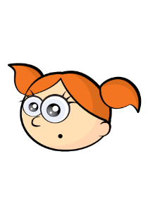
8 cm
A scarf is 96 cm long. How many 8 cm panels does it have?
12 panels
0
8
16
24
32
40
48
56
64
72
80
88
96
10 $×$ 8
0
80
88
96

Slide 5
8 cm
Mr Rose knits a scarf which is longer than 50 cm but shorter than 90 cm.
8 | 16 | 24 | 32 | 40 | 48 | 56 | 64 | 72 | 80 | 88 | 96
Have a think
How long could his scarf be?

Slide 6
Mr Rose knits a new scarf using
panels of 4 cm and panels of 8 cm.
The scarf measures 44 cm.
How many of each panel could he have used?
4 cm
8 cm
Have a think

Slide 7
44 cm
5 $×$ 8 $+$ 4
4 $×$ 8 $+$ 3 $×$ 4
3 $×$ 8 $+$ 5 $×$ 4

Slide 8
Mr Rose has 3 pairs of gloves.
He gets ready in a hurry and pulls on
the first two gloves he finds.
On Monday he wears
On Tuesday he wears
How many different combinations of gloves could he wear?
Have a think

Slide 9
How many different combinations of gloves could he wear?
What if Mr Rose had 4 pairs of gloves?
3 $+$ 2 $+$ 1 $=$ 6
There are 6 different combinations.

Slide 10
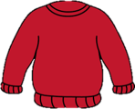
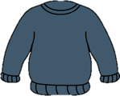
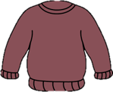
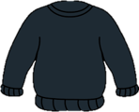
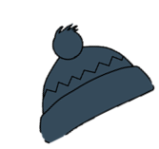
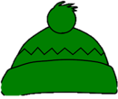
Mo has 4 jumpers.
He always wears them in the same order.
Have a think
Mo has 3 hats. He wears them in the same order too.
On 1st December he wears his red jumper and black hat. When will he next wear them both together again?

Slide 11
On 1st December he wears his red jumper and black hat. When will he next wear them both together again?
1st Dec R $+$ B
6th Dec Bl $+$ G
11th Dec P $+$ Bl
2nd Dec Bl $+$ Bl
7th Dec P $+$ B
12th Dec Gr $+$ G
3rd Dec P $+$ G
8th Dec Gr $+$ Bl
13th Dec R $+$ B
4th Dec Gr $+$ B
9th Dec R $+$ G
5th Dec R $+$ Bl
10th Dec Bl $+$ B
Will this happen again in December?
What if Mo had 5 jumpers?

