Slide 3
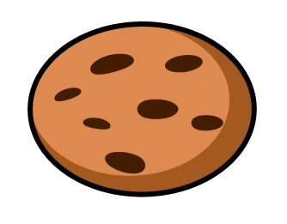
Which sets have one half of the cookies circled?
a)
b)
c)

Slide 4
Which sets have one half of the cookies circled?
a)
b)
c)

Slide 6
Here is a delicious chocolate bar.
Would you prefer one half of the chocolate bar?
Or two quarters of the chocolate bar?

Slide 7
Shade $\frac{\text{1}}{\text{2}}$ of the shapes.
Shade $\frac{\text{2}}{\text{4}}$ of the shapes.
What do you notice?

Slide 8
Have a go at questions 1 – 3 on the worksheet

Slide 9
Shade $\frac{\text{1}}{\text{2}}$ of the shape.
Shade $\frac{\text{2}}{\text{4}}$ of the shape.
Have a think

Slide 10
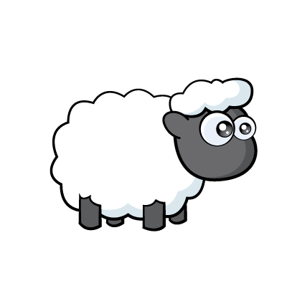
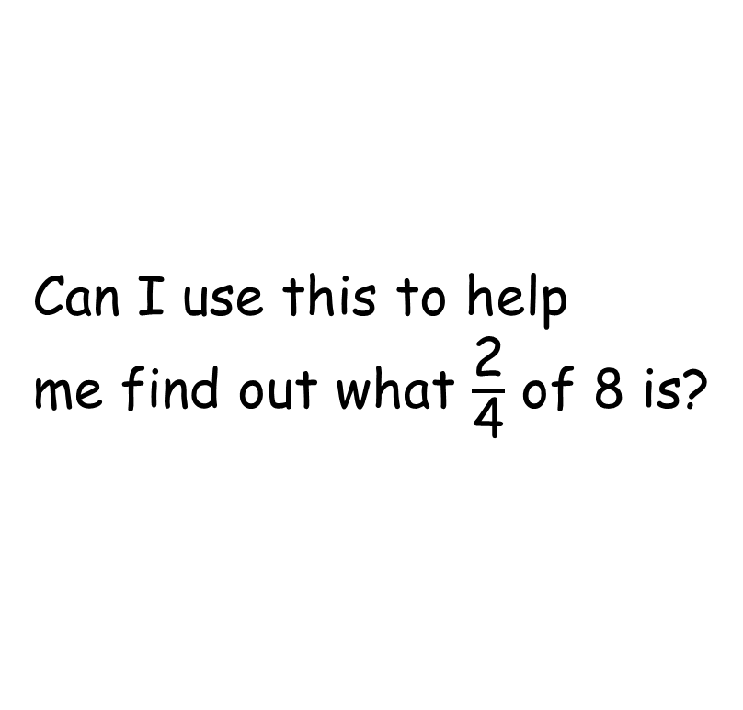
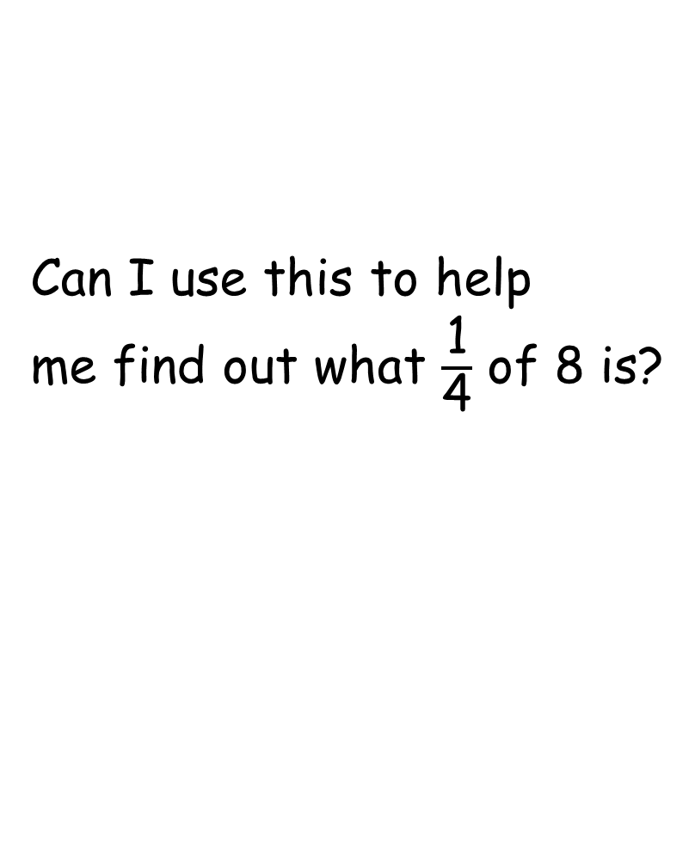
Can I use this to help
me find out what $\frac{\text{1}}{\text{4}}$ of 8 is?
Can I use this to help
me find out what $\frac{\text{2}}{\text{4}}$ of 8 is?
The whole
?
?

Slide 11
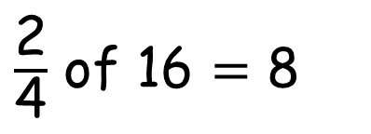
Mo and Amir are finding $\frac{\text{2}}{\text{4}}$ of 16
I think that two quarters of 16 is equal to 8 because half of 16 is 8
Let’s use a bar model to check
$\frac{\text{2}}{\text{4}}$ of 16 $=$ 8
16
8
?

Slide 12
Have a go at the rest of the questions on the worksheet

