Slide 1
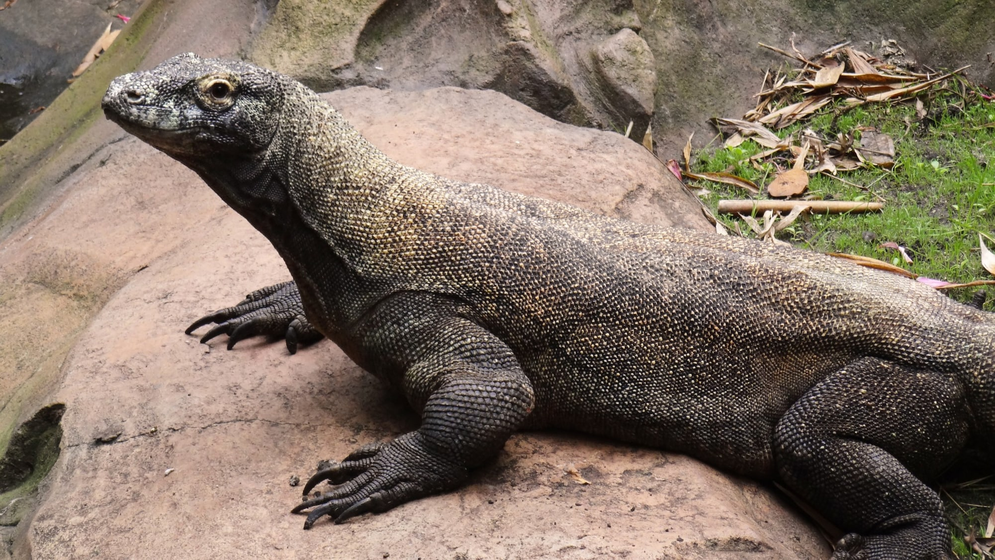
Komodo dragons

Slide 2
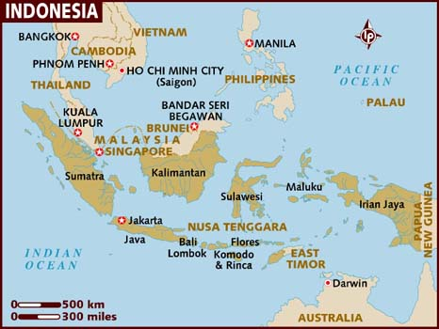
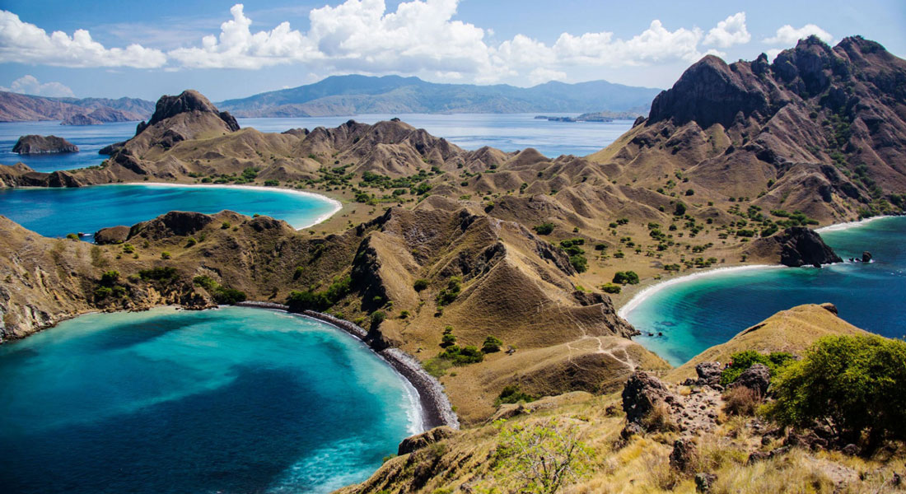
Where does it live?
They live on five islands in Indonesia
One of the islands is called Komodo island

Slide 3
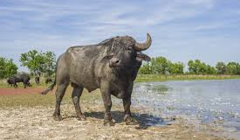
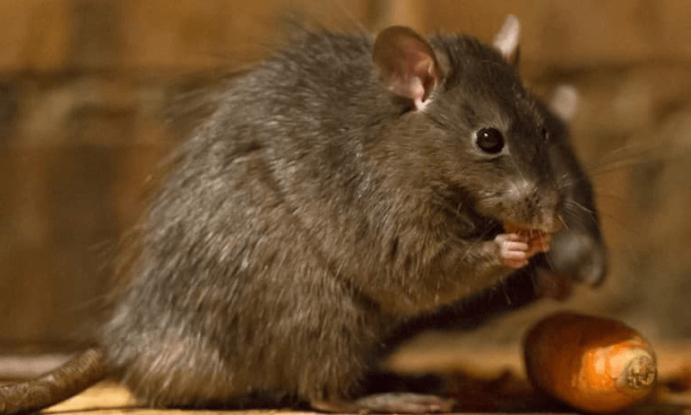
What does it eat?
What they eat?
They can eat any meat from small rodents to big water buffalo
They can eat any type of meat from small
Rodents to big water bufflo.

Slide 4
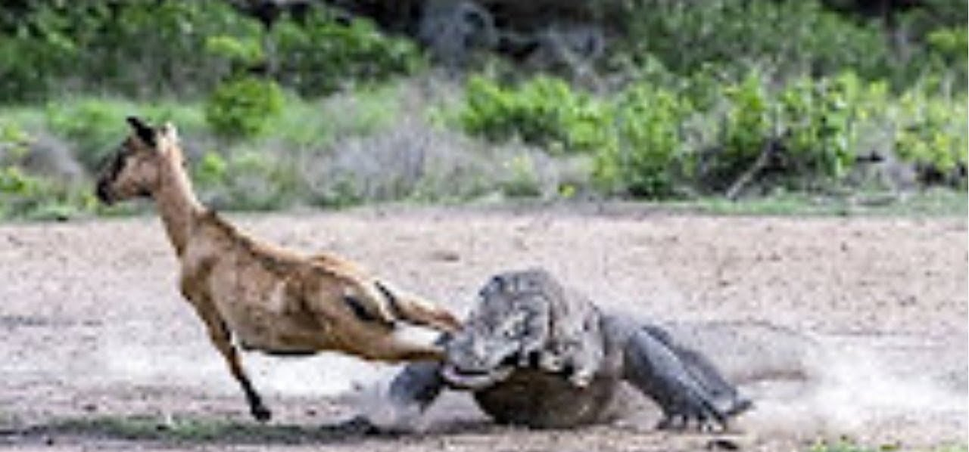
How does it capture its prey
It runs to its prey and bite it

Slide 5
Special features:
The Komodo dragon has a poisonous bite
If you get hit by its tail it will feel like being hit by a mallet hammer.
P.S. these two are fighting!

Slide 6
Food chain

Slide 7
My drawing of a Komodo dragon.

