Slide 1
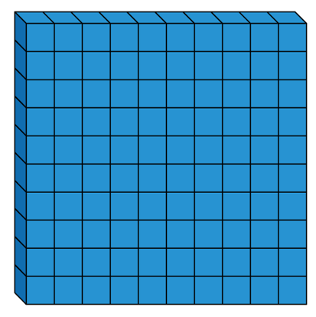
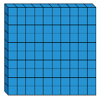
Which image does not represent
339 $–$ 8?
330
340

Slide 2
Alex thinks the chart shows 456 – 4
Do you agree?
Explain why.
Hundreds | Tens | Ones

Slide 3
Always, Sometimes, Never
When 7 and 5 are added together in the ones column, the digit in the ones column of the answer will always be 2
What other digits would always give a 2 in the ones column? Prove it.

Slide 4
Which questions are harder to calculate?
234 $+$ 3 $=$
506 $+$ 8 $=$
455 $+$ 7 $=$
521 $+$ 6 $=$
Explain your answer.

Slide 5
Rosie
Explain Rosie’s method.
When I calculated 392 subtract 20 I used my known fact that
9 $−$ 2 $=$ 7

