Slide 1
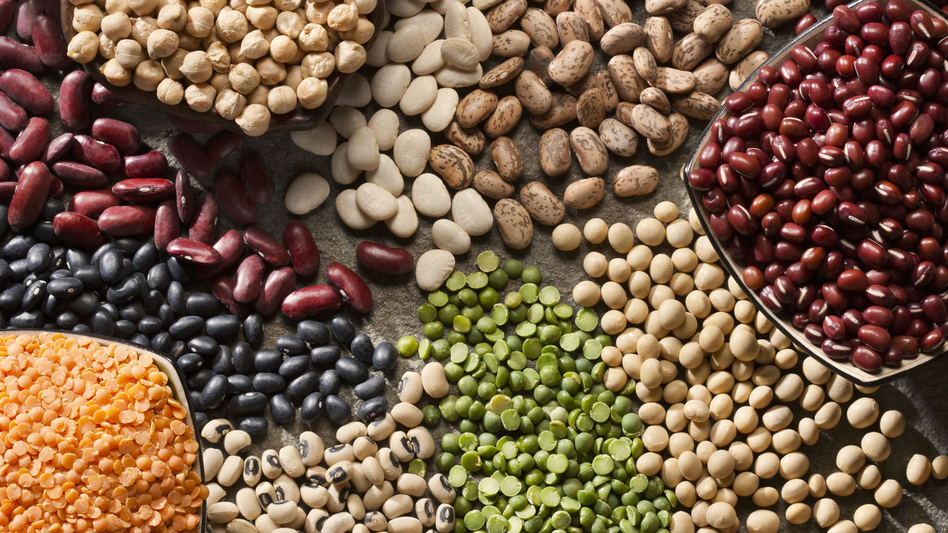
Digestive system

Slide 2
Digestive system
This Photo by Unknown author is licensed under CC BY-SA.

Slide 3
What is digestion?
The food we eat has to be broken down into other substances that our bodies can use. This is called digestion. Without digestion, we could not absorb food into our bodies and use it. Digestion happens in the digestive system. This is a series of organs that break the food down so it can be absorbed into our blood stream.

Slide 4
The mouth
Food enters the digestive system through the mouth. Food is broken down into smaller pieces by chewing.
After being swallowed the food passes down the oesphagus and into the stomach.
This Photo by Unknown author is licensed under CC BY-SA.

Slide 5
stomach
About the stomach
The stomach is an important organ in the digestive system. Food enters the stomach via the oesophagus.
The stomach produces strong acid to break down food so it can be absorbed by the body.
After it leaves the stomach digested food passes into the intestines where it begins to be absorbed.
The stomach

Slide 6
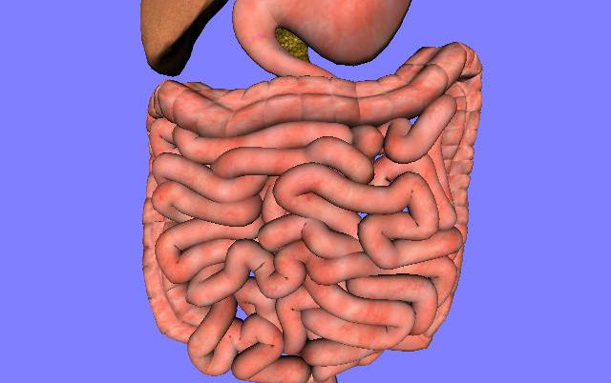
Small and large intestine
Large intestine
The large intestine deals with the waste materials that the body doesn’t need or can't digest. This is called faeces or poo.
Small intestine
Digestive food is absorbed in the small intestine. This means that it passes through the wall of the small intestine and into the blood stream. The blood then carries the useful substances around the body to where they are needed.
This Photo by Unknown author is licensed under CC BY-SA.

Slide 7
Foods that are good for digestion
Vegetables
Fruits
Whole grain foods
Ginger
fiber
Unsaturated fats
Yogurt
Plenty of water

Slide 8
Foods that are bad for digestion
Alcohol
Coffee
Pizza
greasy foods
Foods high and saturated fat
White bread
Spicy foods such as curry

