Slide 3
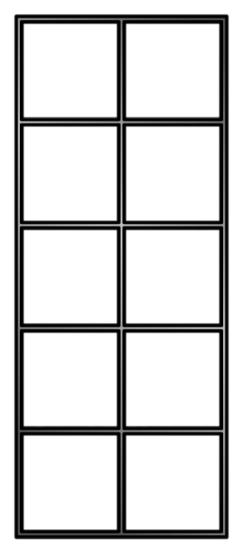
Can you put these inequality symbols in the correct places?
Less than $\text{Greater} \text{than}$ $\text{Equal} \text{to}$
$<$ $>$ $=$
40 $+$ 5 45 .

Slide 4
Can you put these inequality symbols in the correct places?
Less than $\text{Greater} \text{than}$ $\text{Equal} \text{to}$
$<$ $>$ $=$
40 $+$ 5 45 .
$$>$$
$$<$$
$$=$$

Slide 6
How many insects do they see?

Slide 7
Who has more?
1
$$+$$
1
$$<$$
1
$$+$$
3

Slide 8
$$=$$
4 $+$ 4 $=$ 5 $+$ 3
Have a think

Slide 9
Have a go at questions 1 and 2 on the worksheet

Slide 10
Have a think
5 $+$ 2
$$>$$
5 $+$ 1
5 $+$ 2
5 $+$ 1

Slide 11
$$<$$
1 $+$ 2 $<$ 2 $+$ 2
Have a think
$$<$$
5 $+$ 5 $>$ 5 $+$ 3

Slide 12
Have a go at questions 3 and 4 on the worksheet

Slide 13
$$>$$
$−$ 2
$$<$$
$−$ 1
5
5

Slide 14
Have a go at questions 5 and 6 on the worksheet

Slide 15
5 $+$ 2 $=$ 4 $+$ 3
What do you notice?
?

Slide 16
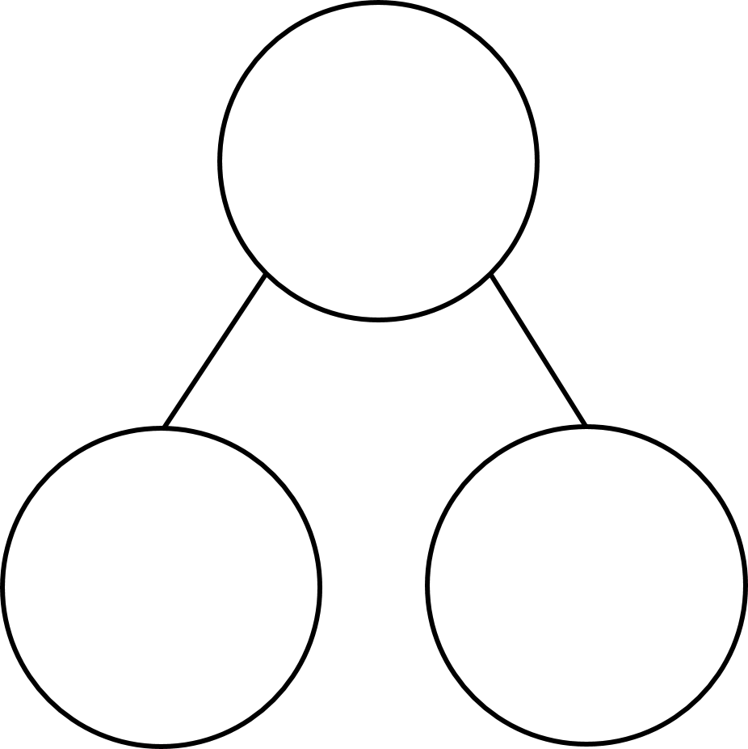
5 $+$ 2 $=$ 4 $+$ 3
What’s stayed the same?
What’s changed?
7
6 is one less than 7
6
1 is one less than 2
5
2
5
1

Slide 17
Have a go at the rest of the worksheet

