Slide 1
Class 2 Writing Friday 15th January

Slide 2
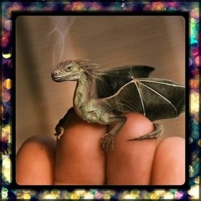
Questions for discussion:
Where is it from?
Why is it so small?
Are there more like him?
Where does he live?
How will you look after it?
Will you keep it a secret or tell someone?
What is it called?
Is it magic? What magic can it do?
I like to imagine that it is a really small dragon which you can keep in your pocket but when you need to it can grow huge so that you can ride it.
Write a story about this dragon. What adventures could you have?

